Slide 1
COBRA Administrative Services
Corporate Research Desk
April 10, 2013
TCS Confidential

Slide 2
Table of Contents
Future of COBRA
Ceridian COBRA administrative services
Comparison of services – Allegiance, Payflex, Ceridian and ADP
ADP Benefits administration
Mobile Solutions – ADP and Payflex

Slide 3
Future of COBRA
COBRA doesn’t appear to be going anywhere anytime soon.
A key element of PPACA, if it remains intact, is the individual mandate that would take effect in 2014. This provision would require most U.S. citizens to purchase health insurance either through their employer if available, or through their state’s health insurance exchange. Government subsidies would help offset costs for low- and modest-income consumers.
As long as the basic system of employer-sponsored coverage remains in place, COBRA coverage will continue to be relevant.
Health care reform will eventually require health plan administrators to provide Summaries of Benefits and Coverage, or SBCs, which will allow individuals to compare various options.
Among the options at stake, according to the regulatory preamble, is COBRA coverage, The fact that regulators intend for the summaries to be used to compare coverage options to COBRA coverage is an indication that they expect COBRA coverage will still be around.

Slide 4
Table of Contents
Future of COBRA
Ceridian COBRA administrative services
Comparison of services – Allegiance, Payflex, Ceridian and ADP
ADP Benefits administration
Mobile Solutions – ADP and Payflex

Slide 5
Ceridian COBRA administrative services
Ceridian has been providing COBRA services since the inception of COBRA in 1986
Ceridian serve nearly 45,000 COBRA employer groups with more than 2,000,000 participants
Ceridian claims to reduce number of COBRA continuants by up to 28%
Ceridian claims to reduce reduce COBRA duration by up to 5%

Slide 6
Table of Contents
Future of COBRA
Ceridian COBRA administrative services
Comparison of services – Allegiance, Payflex, Ceridian and ADP
ADP Benefits administration
Mobile Solutions – ADP and Payflex

Slide 7
Comparison of services – Allegiance, Payflex, Ceridian
Allegiance COBRA Services
COBRA General Notice
PayFlex
Personal service implementation
COBRA Election Notice to Qualified Beneficiaries
All additional notices are required by COBRA regulation, including Termination notice and Unavailability of COBRA notice
Customize COBRA notices for specific client needs
Maintain Federal mandated COBRA documentation
Monitor COBRA regulations and legal opinions
Invoice and collect COBRA premiums
Complete and accurate disclosure to health care providers
Provide a Toll free Customer Service number
State specific Continuation coverage Administration is also available
Current plan member COBRA general rights renotification
1st class mailing of all required COBRA notices with proof of mailing
HIPAA special enrollment rights notification
HIPAA Certificate of Creditable Coverage and statement of portability rights
Premium collection and paid-through date reporting
Real-time and monthly participant status reports
HIPAA 834 and proprietary carrier file format for eligibility data transmission
Certificate of Creditable Coverage at loss of coverage
Certificate of Creditable Coverage at COBRA termination
Monitors HIPAA regulations, legal opinions and notification requirements
Employer and Participant web portals
Ceridian
COBRA notifications and correspondence
COBRA elections and qualifying event processing
COBRA billing and payment processing
COBRA premium remittance with itemized reports
Full or partial open enrollment services
Participant call center and 24-hour IVR
Client Value Dashboard
Compliance updates
Records archiving
Online, phone, mail or walk-in premium payments
HIPAA compliance services
Additional services available include:
Continuation Coverage Alternatives (CCA) — Alert participants of alternate coverage options following a COBRA qualifying event or termination
Benefits Billing Services (BBS) — A cost-effective way to bill, collect, process and report benefits premiums from retirees and other non-active employees not covered under COBRA
Notes:
http://www.payflex.com/index.php?option=com_content&view=article&id=27&Itemid=400009
http://www.allegiancecobra.com/AboutUs.asp
http://www.ceridian.com/resources/data-sheets/benefits-continuation.html

Slide 8
Comparison of services - ADP
For Mid-size companies
Distributing notifications, correspondence, election packets, and COBRA termination notices as required by law
Maintaining qualifying events and HIPAA loss-of-coverage data on-line
Processing election forms, and tracking key dates to help ensure accurate and timely responses to COBRA administrative requirements
Providing HIPAA Certificates of Creditable Coverage (optional)
For Large Companies
Fast, easy on-boarding and implementation
Notification distribution, forms processing and data tracking, including:
COBRA termination notices, election packages and other forms of correspondence
Election and termination, and key dates tracking to help you adhere to COBRA administration requirements
Qualifying events and loss-of-coverage data online
Health Insurance Portability and Accountability Act (HIPAA) certificates of creditable coverage
Accurate processing of transactions, such as qualifying event notices, premium invoices and premium payments
Close integration with ADP’s eligibility and enrollment solutions for tracking COBRA qualifying events
Accommodation of federal regulations and applicable guidance
The ability to make payments online
A self-service website for administering their COBRA benefits
Toll-free help from a dedicated call center

Slide 9
Table of Contents
Future of COBRA
Ceridian COBRA administrative services
Comparison of services – Allegiance, Payflex, Ceridian and ADP
ADP Benefits administration
Mobile Solutions – ADP and Payflex

Slide 10
ADP Benefits administration
Small Size Business
Group Health Benefits for Small Businesses
Mid-size business
ADP Workforce Now provides a flexible, online solution for mid-sized businesses supported by hands-on service and expertise.
Large Business
Additional Benefits Services
Analytics and Decision Support
COBRA
Dependent Verification
Eligibility and Enrollment
Employee Communications Services
HR Service Center
Leave of Absence
Print and Fulfillment
Reimbursement and Spending Accounts
Strategic Advisory Services
Payroll
Time and Attendance
Human Resources and Talent Management
Benefits Administration
Professional Employer Organization (PEO)
A PEO is simply a relationship in which you select a provider to become your dedicated HR management and benefits administration partner, and deliver a broad range of HR services through a “co-employment” model. In a standard PEO, you retain the day-to-day control over how you manage your employees, and your provider handles the HR management and benefits administration.
ADP TotalSourceSM integrates all major HR management and employee benefits functions into a single-source solution.
Notes:
http://online-payroll-service-review.toptenreviews.com

Slide 11
Table of Contents
Future of COBRA
Ceridian COBRA administrative services
Comparison of services – Allegiance, Payflex, Ceridian and ADP
ADP Benefits administration
Mobile Solutions – ADP and Payflex

Slide 12
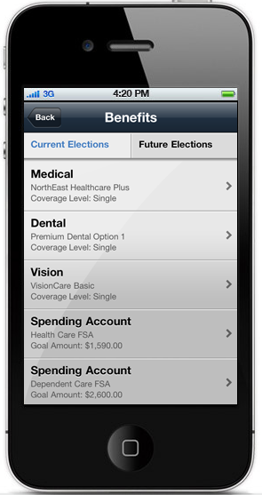
Mobile solution - ADP
Important features
View by benefit category, plan type and coverage level
Detailed views include effective date, per pay period deduction and employer contribution
Enable easy access to Benefits plan information.
Provide employees with immediate access to existing and future benefit elections by benefit category, plan type and coverage level.
Notes:
http://www.adp.com/mobilesolutions/employee/index.html``

Slide 13
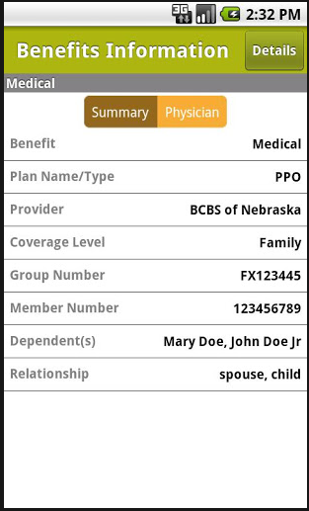
Mobile solution - Payflex
PayFlex Mobile app is available for iPhone®, BlackBerry® and Android™
PayFlex Mobile provides real-time access to account balances, claims processed and transaction details for your FSA, HSA or HRA accounts.
PayFlex Mobile notifies of a change in account status and when action is needed on account.
Allows to submit a claim on the go. Using phone, choose the expense type, the date and amount of expense and attach receipt.
If you receive a request to verify a purchase made with PayFlex Card®, use phone's camera to take a picture of receipt and upload it from device.
PayFlex Mobile allows you to access health plan information and a listing of eligible expenses to make informed decisions on the spot.

Slide 14

Send your feedback / suggestions to the analyst team:
Aditi.Royghatak@tcs.com
Rohit5.j@tcs.com@tcs.com
Sonnet.Das@tcs.com
Visit us on Knowmax at:
https://knowmax.ultimatix.net/sites/mrkt-corpfn/mrktint/default.aspx

